Slide 1

Tugay Özdemir, Isabel Fisher, Qingtian Liao, Anna Huttner

Slide 2


Slide 3

Side Facts
YouTube has more than 2.7 Billion users per month.
YouTube has more than 51 million active channels.
Most YouTube users fall in the age group of 25-34.

Slide 4
Standard User Experience

Slide 5
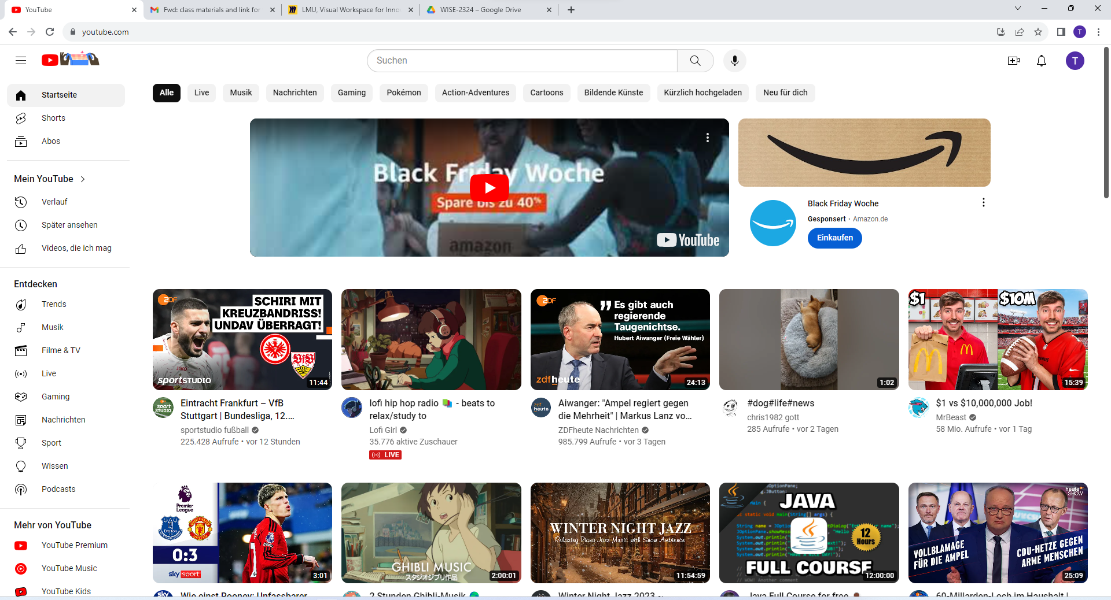

Slide 6
GET

Slide 8
Search Bar
INPUT
Server Data
GET – Method
Search Results
OUTPUT

Slide 10
Sign-In
Google API
E-Mail/Password
GET- Method
User authorisation
ERROR

Slide 12
POST

Slide 13
Personalized Section
Add Video to e.g. „watch later“ list
POST-Method
Array
Watch List

Slide 14
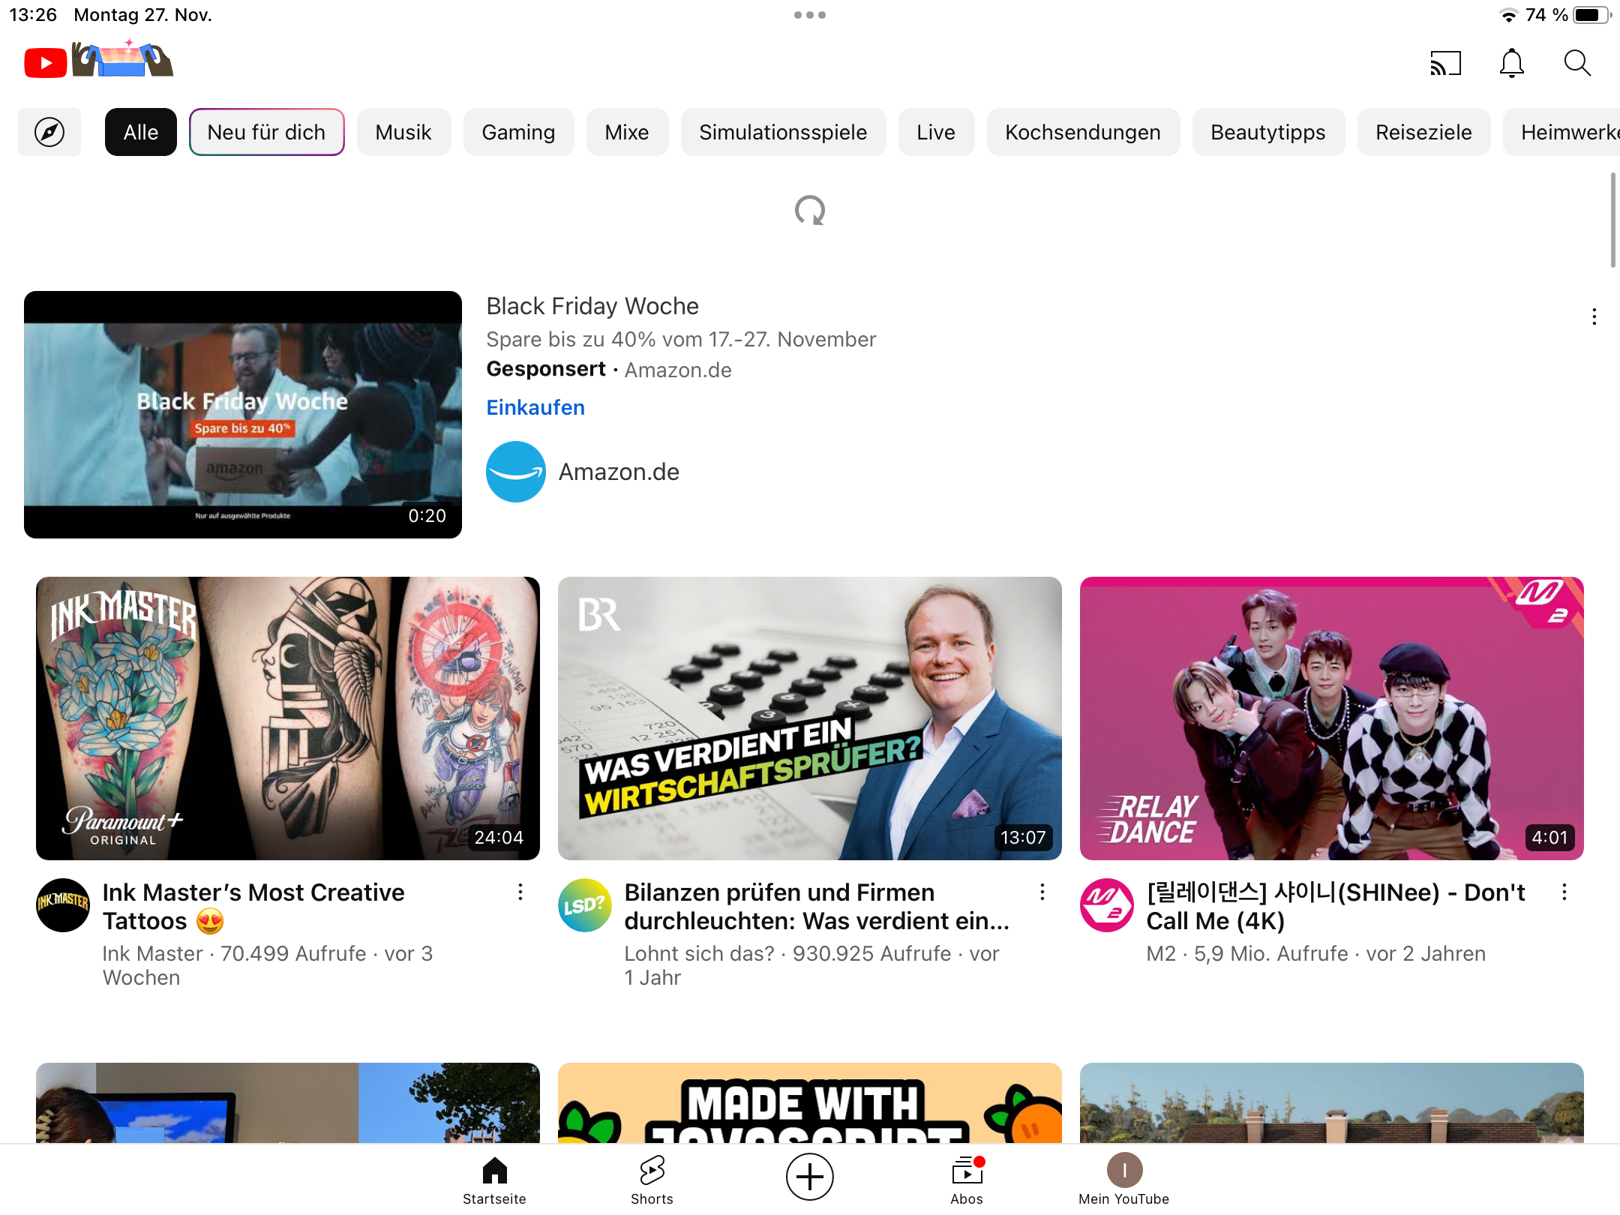

Slide 15
PUT

Slide 16
Refreshing
Refreshed Page
PUT-Method

Slide 18
Video
GET- Method
Watch Video

Slide 19
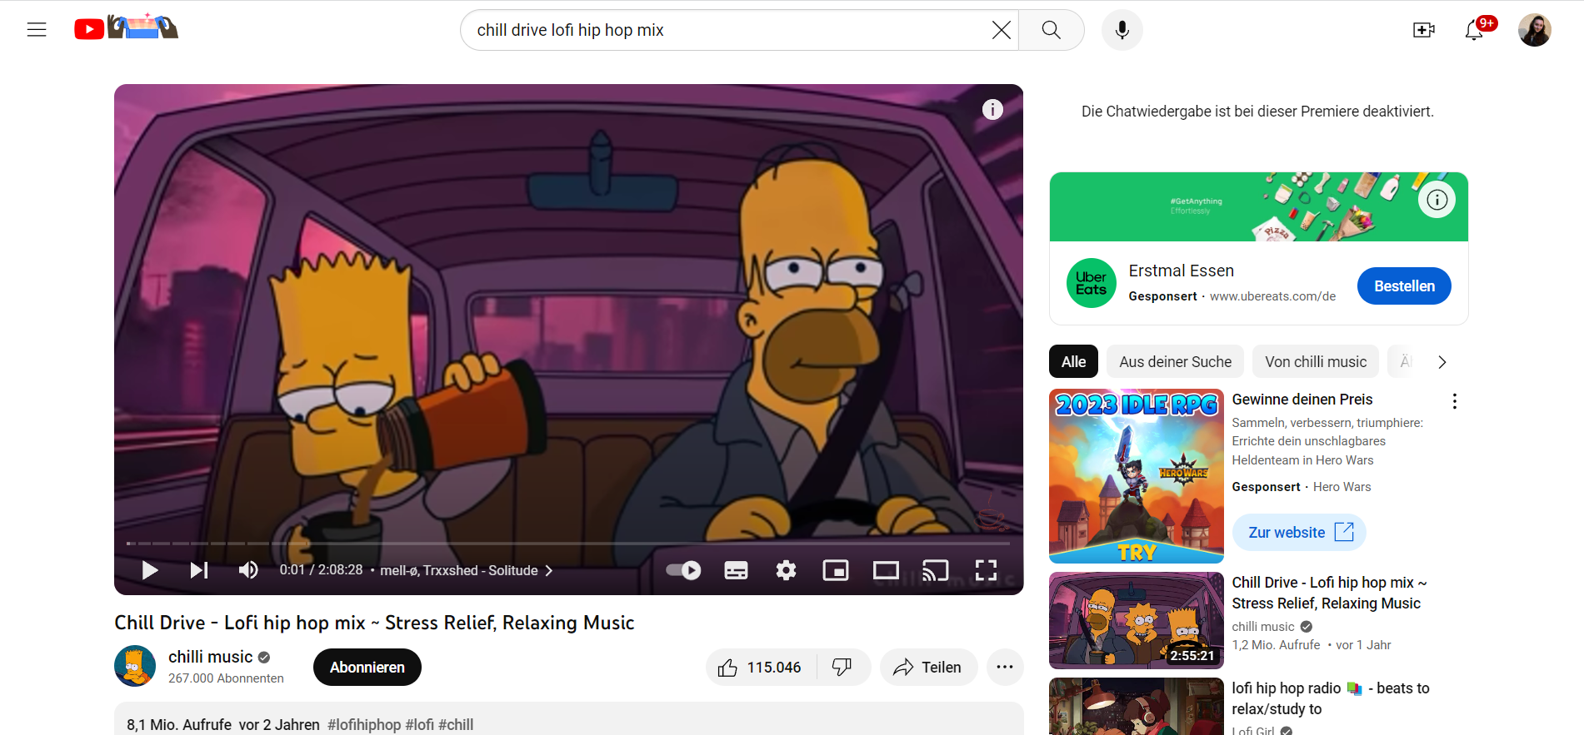

Slide 20
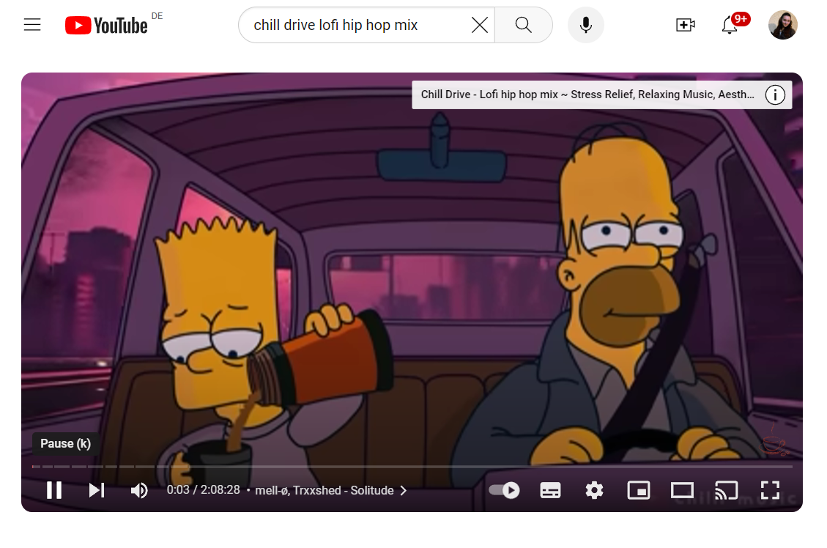

Slide 21
Pause Button
Post- Method
Pause Video

Slide 22
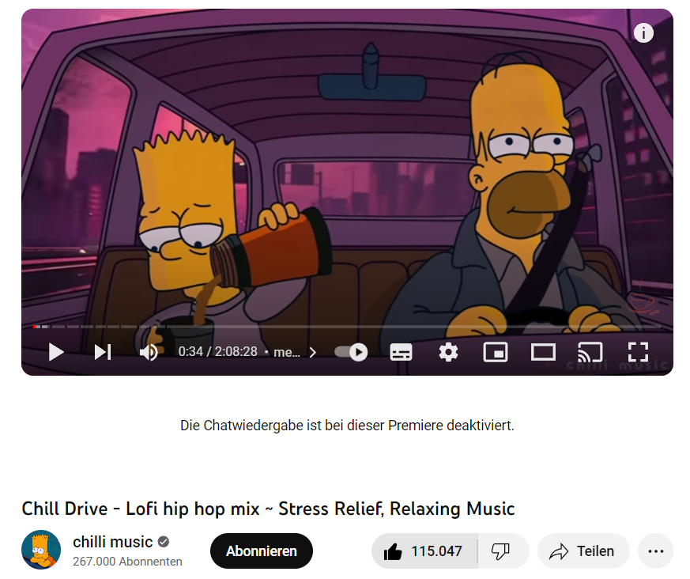

Slide 23
Thumbs up
Post- Method
Video gains one like

Slide 24
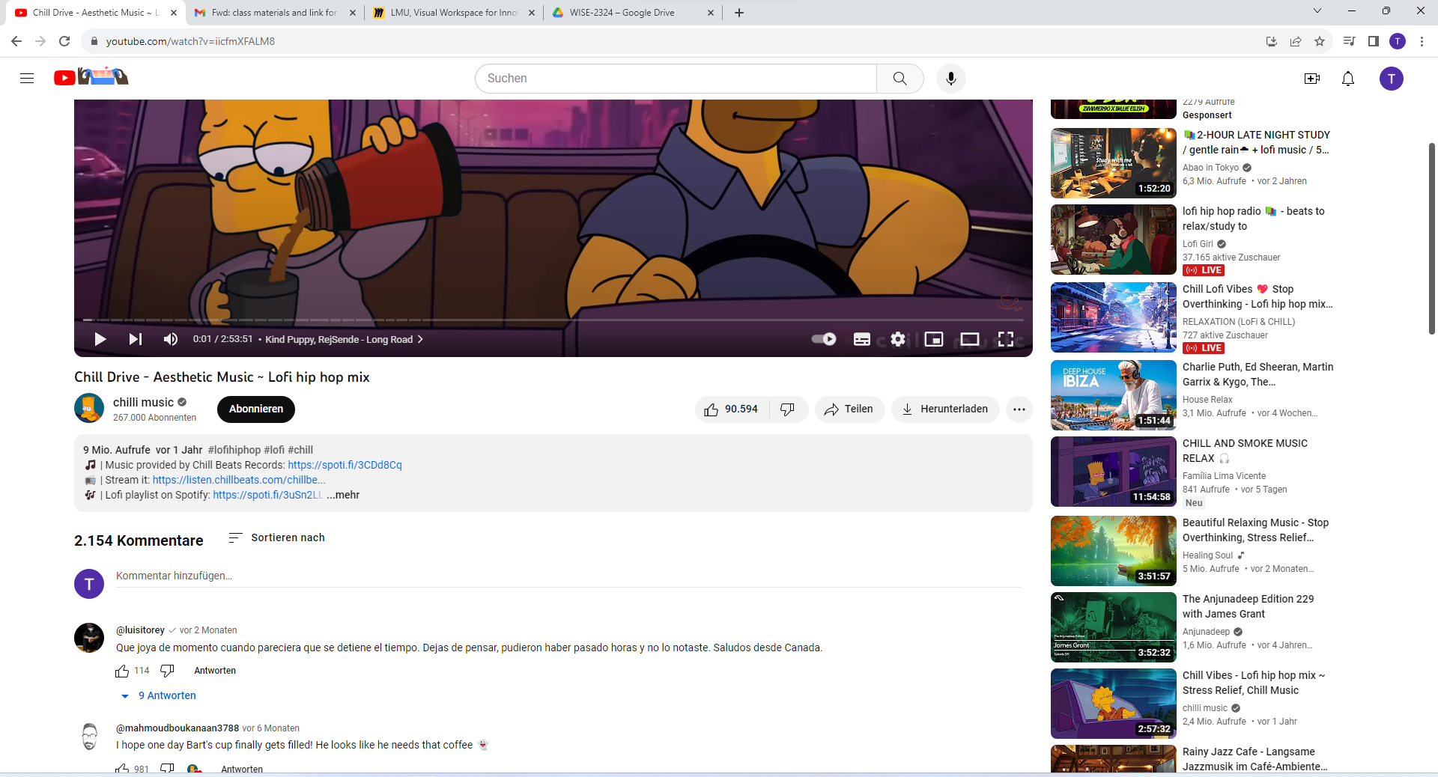

Slide 25
Write comment
POST- Method
Edit comment
PUT- Method
Comment-Section
Delete comment
Delete- Method

Slide 26
DELETE

Slide 27
Creator
Experience

Slide 28
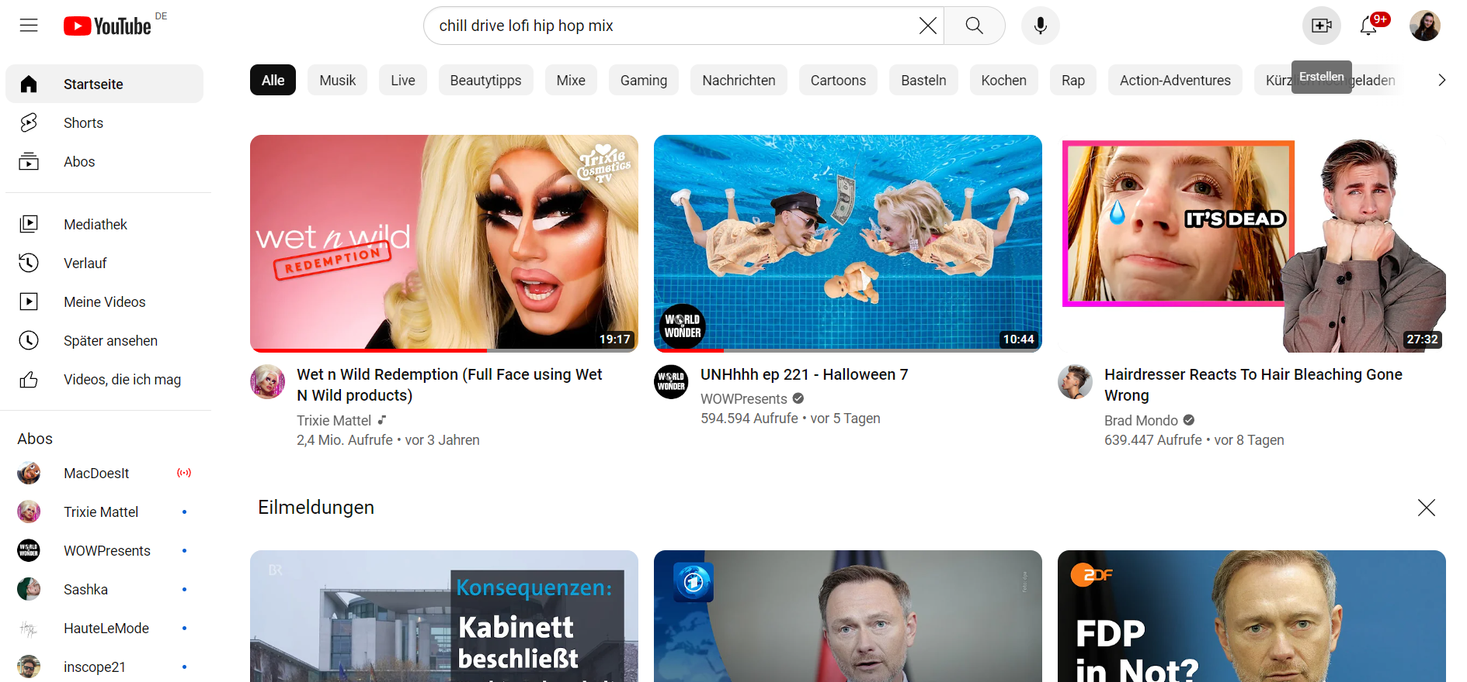

Slide 29
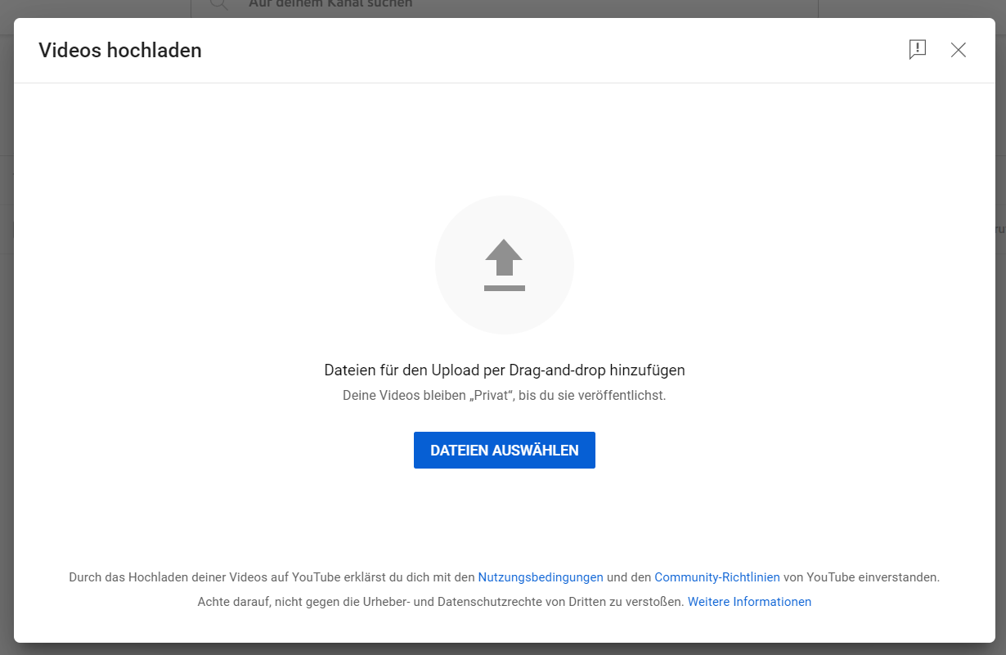

Slide 30
Video
POST- Method
Upload Video
Array
Video List

Slide 31
POST- Thumbs up, Pausing, Uploading videos
GOT- viewing videos, search button
PUT- altering a comment, editing your video
DELETE- deleting a comment or video

